Slide 1
Topics to be covered
Introduction to Microservice
Pros and Cons of Microservice architecture
Introduction of Spring boot
Creating first Microservice with Spring boot
Database connection with PostgreSQL
Spring boot features implementation: Maven, Actuator, logging,caching,security.

Slide 2
Prerequisite
Basic programing knowledge (Java)
Basic Knowledge of Spring and Hibernate
Familiar with any IDE. ex. Eclipse, IntelliJ
Environment setup including Java, Maven, any IDE

Slide 3
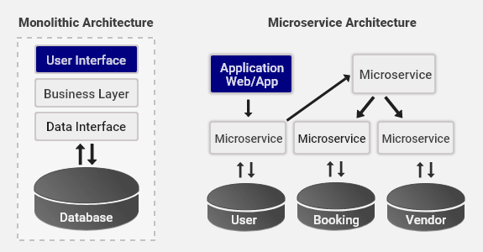

Slide 4
Overview
Microservices communication can be :
Sync(HTTP/HTTPS) :
Async (AMQP)
Decomposing microservice can be done using:
Business capabilities
Domain driven design

Slide 5
Pros and Cons
High Maintainable and testable
Easy to understand
Multiple teams can work parallely
Fast deployment
Independent service and loose coupling
No single point of failure
Scalability is high
Independent deployment
Cost is high as more server is required.
Data replication and consistency cost
Development cost is high
Latency
More memory consumption

Slide 6
Create First Spring boot
Download the initial project from : https://start.spring.io/
Maven: Maven is a build automation tool (Dependency Management)
Two types of dependencies are: Direct and Transitive.
Scopes:
Compile
Provided
Runtime
Test
System

Slide 7
Actuator
Provides endpoints for monitoring and managing your Spring Boot application.
<dependency>
<groupId>org.springframework.boot</groupId>
<artifactId>spring-boot-starter-actuator</artifactId>
</dependency>
Endpoint: http://localhost:9090/actuator/
# ENDPOINTS WEB CONFIGURATION
management.endpoints.web.exposure.include=*
# HEALTH ENDPOINT
management.endpoint.health.show-details=always

Slide 8
Security
Basic security can be provided by just adding below dependency:
<dependency>
<groupId>org.springframework.boot</groupId>
<artifactId>spring-boot-starter-security</artifactId>
</dependency>
<dependency>
<groupId>org.springframework.security</groupId>
<artifactId>spring-security-test</artifactId>
<scope>test</scope>
</dependency>
Write a Configuration class to extend WebSecurityConfigurerAdapter with @EnableSpringSecurity and @Configuration
# Spring Security default user name and password
spring.security.user.name=test
spring.security.user.password=test123

Slide 9
Swagger
Swagger is API documentation framework which can be integrated with spring boot:
<dependency>
<groupId>io.springfox</groupId>
<artifactId>springfox-boot-starter</artifactId>
<version>3.0.0</version>
</dependency>
Endpoint: http://localhost:9090/swagger-ui/

Slide 10
RestController
@Controller specialization of the @Component class, which allows us to auto-detect implementation classes through the classpath scanning.
@RestController is a specialized version of the controller. It includes the @Controller and @ResponseBody annotations.
REST is REpresentational State Transfer, In REST data and functionality are considered resources and are accessed using Uniform Resource Identifiers.(URI’s).
The clients and servers exchange representations of resources by using a standardized interface and protocol. Typically HTTP is the most used protocol.
Various method used to modify resource are:
GET, PUT,POST,DELETE

Slide 11
Database Connection
Maven Dependency
<dependency>
<groupId>org.postgresql</groupId>
<artifactId>postgresql</artifactId>
<scope>runtime</scope>
</dependency>
<dependency>
<groupId>org.springframework.boot</groupId>
<artifactId>spring-boot-starter-data-jpa</artifactId>
</dependency>
Application Properties settings:
spring.datasource.url=jdbc:postgresql://localhost:5432/test
spring.datasource.username=postgres
spring.datasource.password=imran

Slide 12
Questions
For any queries:
Mail @ ahmad.imran27@gmail.com
LinkedIn: https://www.linkedin.com/in/imran-ahmad-45708562/

